Slide 1
République de Bulgarie

Slide 2
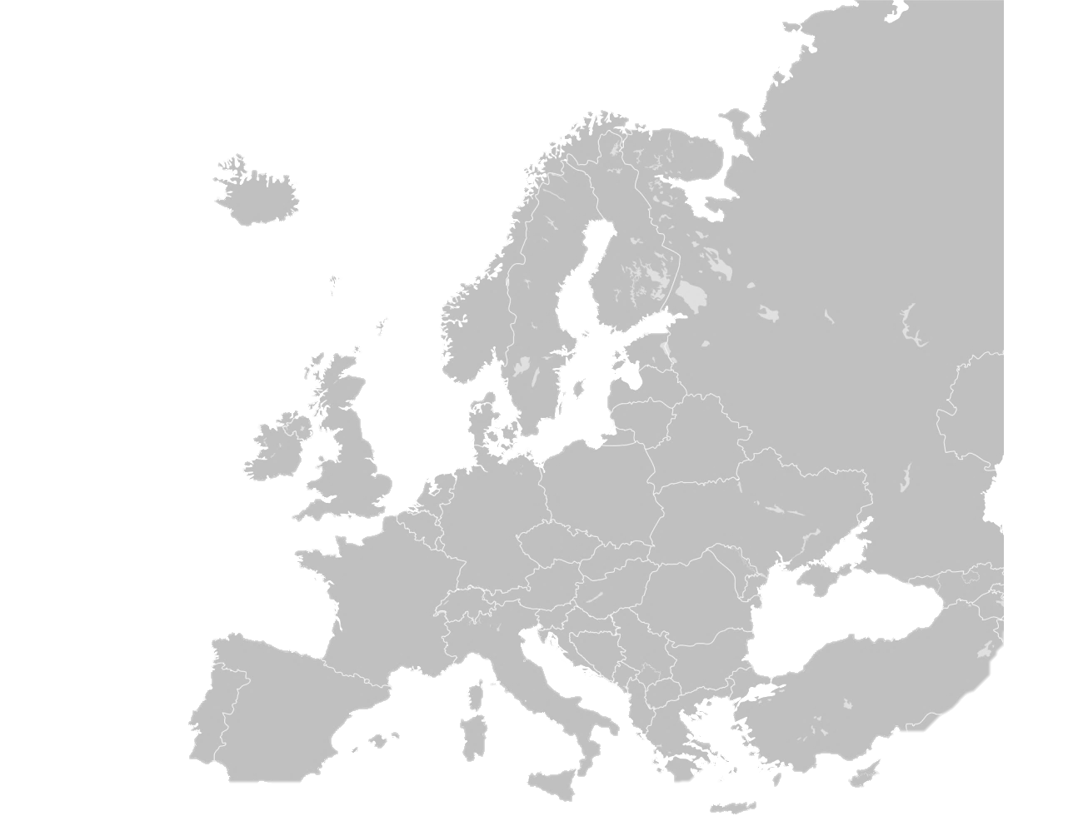

Informations générales
  Fondée en 681
  Europe du Sud-Est, Péninsule balkanique, bordant la mer Noire et le Danube
  Pays voisins: Roumanie, Serbie, République de Macédoine, Grèce, Turquie
  Superficie: 110 910 km²
  Population: 7 504 868
  Capitale: Sofia
Notes:
La Bulgarie est l'un des plus anciens pays d'Europe et précède même l'Empire romain.
La Bulgarie est le 16ème plus grand pays de l'UE.
Sofia est la 13ème plus grande ville de l'UE. C'est la deuxième plus ancienne ville d'Europe.

Slide 3
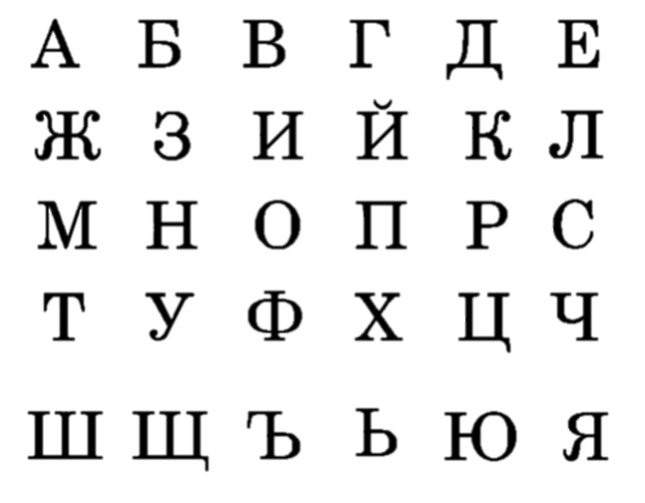
Informations générales
  Langue: Bulgare
  Alphabet cyrillique
  Monnaie: LEV (BGN)
  Grandes villes : Plovdiv (la plus ancienne ville continuellement habitée en Europe et la cinquième plus ancienne ville du monde), Varna, Bourgas, Veliko Tarnovo (l'ancienne capitale du deuxième royaume bulgare)
Notes:
La Bulgarie est le seul pays d'Europe qui n'a pas changé de nom depuis sa création 681 après JC.
L'alphabet cyrillique est devenu le troisième alphabet officiel de l'UE. La plus ancienne langue slave écrite.
La Nécropole de Varna - le plus ancien trésor d'or du monde, datant de 4600 avant JC à 4200 avant JC. Les ornements sont thraces et ont été trouvés sur le squelette d'un homme d'environ 45 ans. (dans 294 tombes ont été trouvés 3000 objets en or datant de plus de 6000 ans).

Slide 4
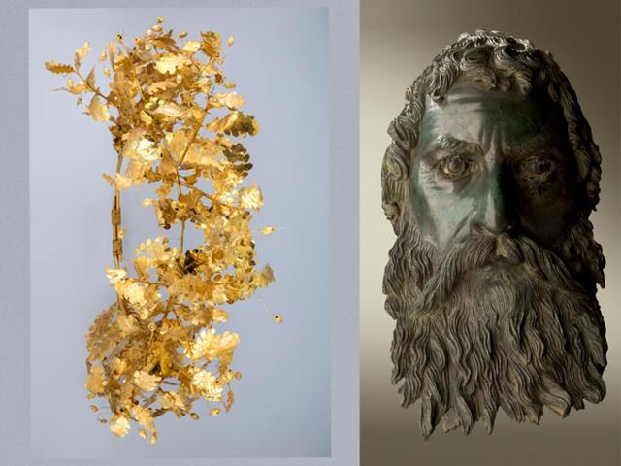
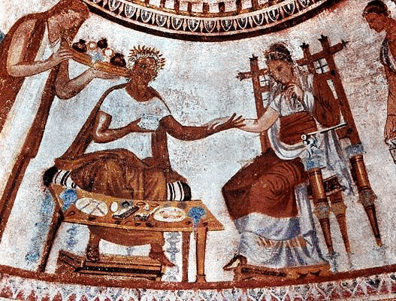
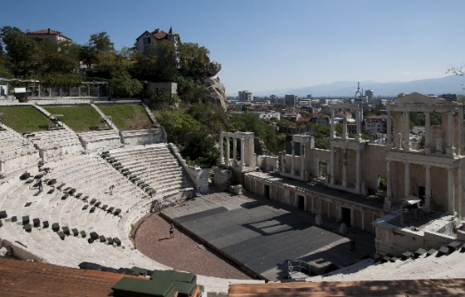
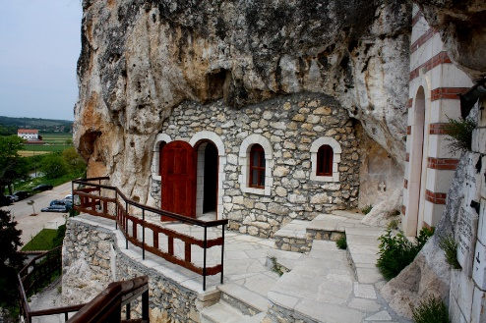
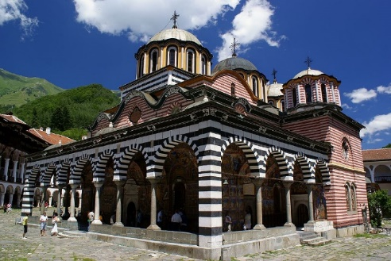
Patrimoine culturel
  10 sites du patrimoine mondial reconnus par l'UNESCO en Bulgarie
  Civilisations Thrace, Byzantine et Romaine
  Monastères médiévaux
Voix bulgares extraordinaires (une chanson folklorique bulgare volant à travers l'espace sur le vaisseau spatial Voyager), chanteurs d'opéra célèbres dans le monde entier

Slide 5
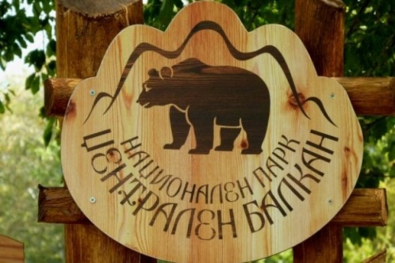
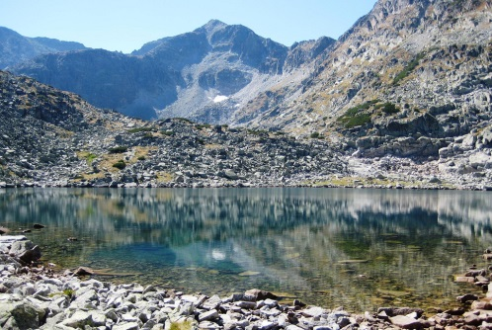
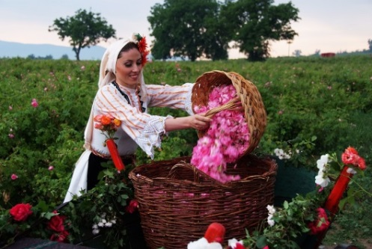
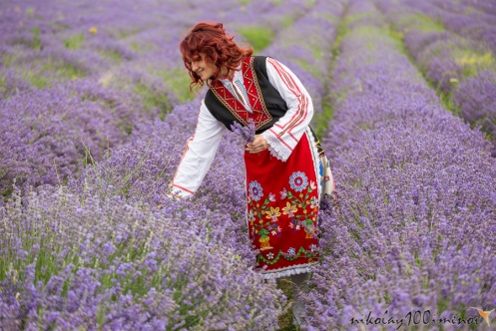

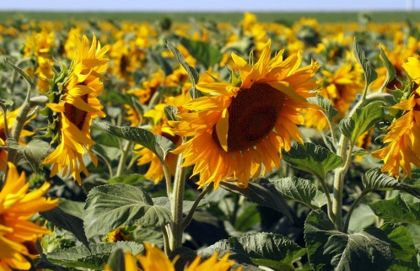
Nature
  Vallées fertiles
  Forêts vastes et variées
  Hautes montagnes - Sommet de Musala, 2925m, le plus haut sommet de la péninsule balkanique
  Belle côte
  Vallée des roses
  Excellentes conditions pour l'agriculture
Notes:
Nearly 1\3 of Bulgaria is covered in forests; Nearly 2% of the land of the country is parks
27 October 1934 Vitosha became the first nature park on the Balkan Peninsula.
Musala; from Arabic through Ottoman Turkish: from Musalla, "near God" or "place for prayer" is the highest peak in the entire Balkan Peninsula, standing at 2,925 m.
Agriculture - Bulgaria ranks as one of the top world producers of agricultural commodities such as anise (6th in the world)
sunflower seed (11th) - The largest exporter of sunflower seeds worldwide in 2013. Our market share in the exports of this commodity in the planet is 17.8%.
tobacco (15th)
Lavender - First in the world in the production of lavender. For the past three years, our country has managed to surpass France from the first place and France is historically a leader in this field.
Rose oil - In September 2014 the European Commission approved Bulgarian Rose Oil («Bulgarsko rozovo maslo») as a new Protected Geographical Indication (PGI).
The roses grown in Bulgaria’s “Rose Valley” produce most (70-85%) of the world’s rose oil – a component in most perfumes.
Wine

Slide 6
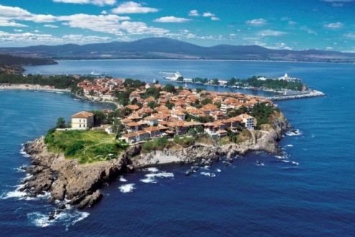
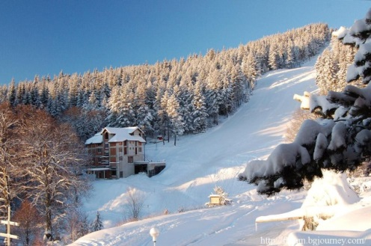
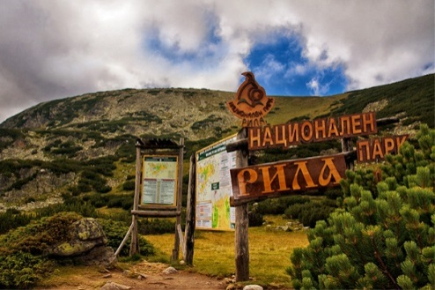
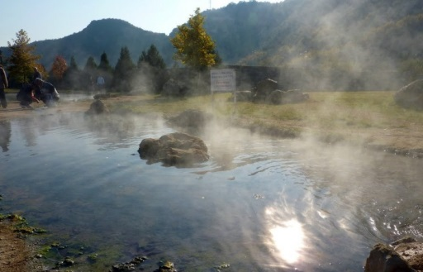
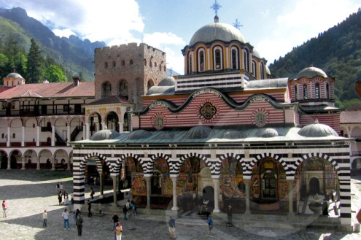

Tourisme
  Tourisme côtier
  Tourisme de montagne et de ski
  Tourisme écologique
  Balnéologie et Tourisme balnéaire (SPA)
  Tourisme culturel
  Tourisme de chasse
  Tourisme oenologique
Notes:
Tourism is one of the key sectors in Bulgaria due to the excellent geographical location, remarkably rich nature, diverse relief and moderate continental climate.
Coastal tourism – The Black Sea Coast offers attractive seaside resorts
Mountain and ski tourism - Their tourism development potential is large, both during the summer and the winter. Some of Bulgaria’s winter sports centers are well-known worldwide and attracting large number of tourists from many countries.
Balneology and Spa Tourism - Among Bulgaria’s most valuable natural resources are the unique qualities, diversity and abundance of hydrothermal mineral water, curative mud, the sea, and other health resources.
Bulgaria ranks second in Europe after Iceland in the number of the mineral springs, providing all types of mineral water existing in nature.
A network of three national and nine nature parks, a number of reserves and natural places represent a significant potential for the development of ecological tourism.
Cultural tourism -Bulgaria is a country of ancient history, ethnological and cultural heritage, and beautiful natural scenery
about 40,000 historical monuments have been registered in Bulgaria
Bulgaria has over 30,000 historical monuments from different historical epochs, 36 culture reserves, 330 museums and galleries that form an impressive base for the development of cultural tourism.
The hunting tourism in Bulgaria relies on a large variety of game: red deer, fallow deer, roe deer, wild goat, bear, boar, grouse, hare, partridge, pheasant and many others. Bulgaria ranks second in the world in terms of the quality of shot trophies.

Slide 7

Faire des affaires, pourquoi choisir la Bulgarie?
  Stabilité politique et économique
  Faible coût pour faire des affaires
  Ressources humaines
  Location stratégique
  Accès aux marchés

Slide 8
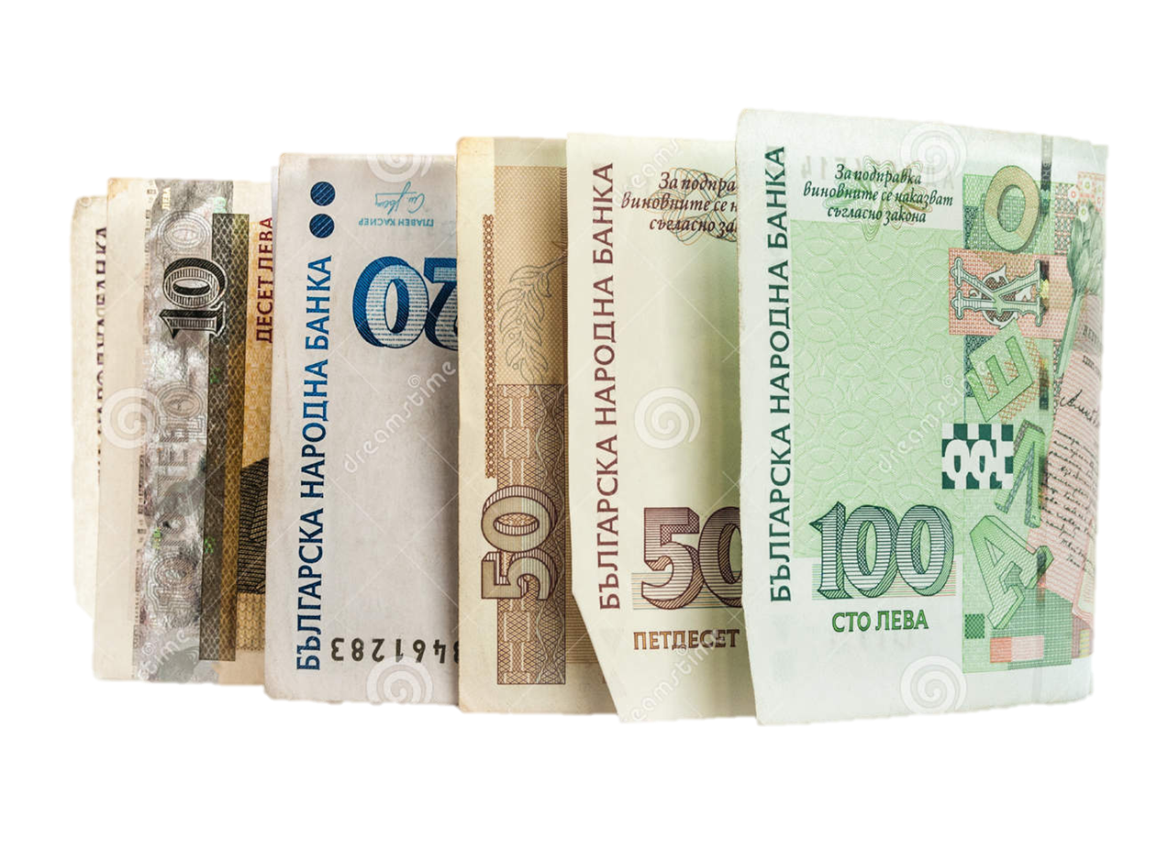
1. Stabilité politique et économique
  Membre de l’EU (2007) et de l’ OTAN (2004)
  Currency board
  Solde budgétaire public
  Dette publique faible (25%)
  Faible inflation (1%)
  Croissance du PIB (3,9%)
Notes:
Bulgaria offers a combination of political and macroeconomic stability and many incentives for doing business:
Stable parliamentary democracy - member of the EU, NATO and the World Trade Organization
The Bulgarian currency is pegged to the Euro under a Currency Board
The lowest tax rates and some of the lowest labour costs in the EU, backed by specific incentives for investors in the country
EU funding - more than 10 billion Euro from EU funds in the next few years

Slide 9
2. Faible coût pour faire des affaires
  L'un des coûts les plus compétitifs en Europe
 | Impôt sur le revenu (%) |  | Sécurité sociale (%)
Pays | Entreprise | Individuel | Employeur | Employé | TVA(%)
Bulgaria | 10 | 10 | 17.9-18.5 | 12.9 | 20
Serbie | 15 | 10-20 | 16.9 | 16.9 | 20
Roumanie | 16 | 16 | 28.45 | 16.5 | 24
Rép. Tcheque | 19 | 22 | 34 | 11 | 21
Pologne | 19 | 18/32 | 22.14 | 13.7 | 23
Turquie | 20 | 15-35 | 27 | 15 | 18
Slovakie | 23 | 19-25 | 34.8 | 13.4 | 20
Royaume Uni | 23 | 0-45 | 13.8 | 12 | 20
Italie | 27.5 | 23-43 | 30 | 10 | 21
Espagne | 30 | 24, 75-52 | 29.9 | 6.35 | 21
Allemagne | 30-33 | 14-45 | 19.7 | 20.6 | 19
France | 33.33 | 5.5-41 | 50 | 20 | 19.6
Chypre | 12.5 | 20-35 | 7.8 | 7.8 | 19
Notes:
Bulgaria has the most favourable tax regime in Europe. Corporate income tax rate is 10%, the lowest in the EU. Personal income tax is 10 %, flat rate. Industries in high-unemployment areas are granted 0% tax rate
There is a 2-year VAT exemption for imports of equipment for investment projects over €5 million, creating at least 50 jobs
Depreciation time for computers and new manufacturing equipment is 2 years
5% withholding tax on dividends and liquidation quotas (0% for EU tax residents)
Bulgaria has one of the most competitive costs of labor in Central and Eastern Europe
Favorable office rents and low cost of utilities. Bulgarian cost of electricity for industrial users is 70% of the European average

Slide 10

3. Ressources humaines
  Caractéristiques de la population active:
    Bonne éducation
    Haute qualification
    Multilingue
Notes:
Educated & skilled workforce - Work force is well educated, highly skilled and multilingual
80 000 students abroad
25% of population hold university degree
46% of population speak at least one foreign language
62.2 % of the total population is in working age (appr. 4.6 million)
60 000 students annually graduate from 51 universities
98% of the high school students study a foreign language (usually English) and 73% study a second language (mainly German, French, Spanish, Russian)
94% of the schools have Internet access
According to Mensa, Bulgarians are 2nd internationally in IQ scores as well as SAT scores. Among Mensa’s smartest people in the world, the most clever woman is Bulgarian Daniela Simidchieva, who achieved an IQ score of 200.
Literacy rate 98.4%

Slide 11
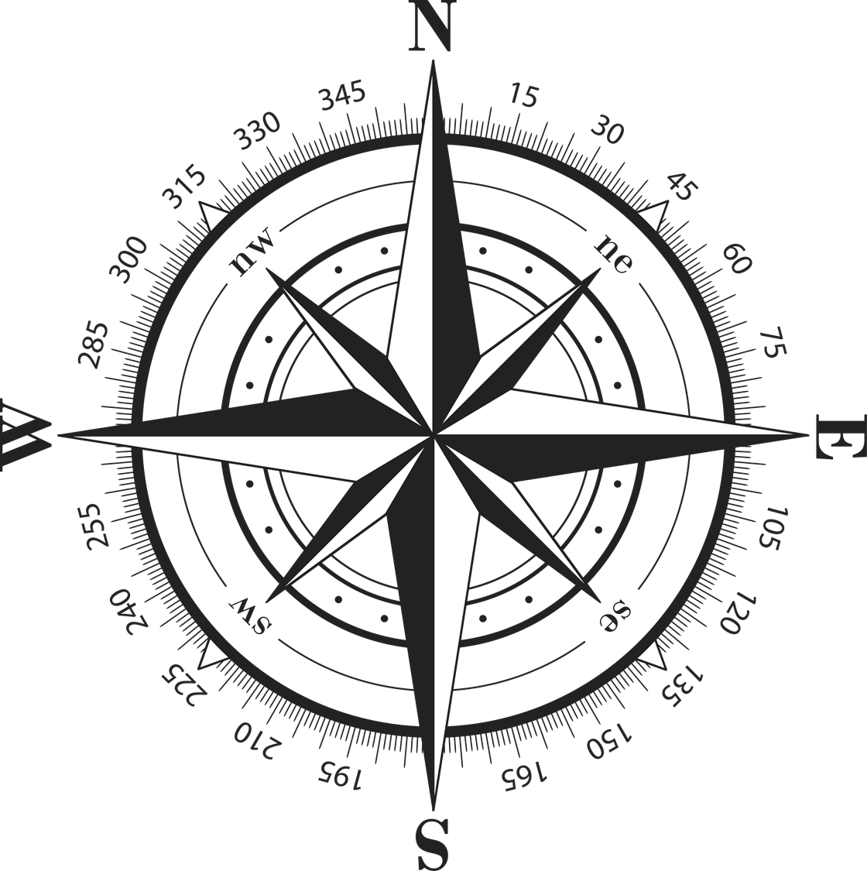
4. Location stratégique
      Cinq corridors paneuropéens (IV, VII, VII, XI, X)
      Quatre grands aéroports: Sofia, Plovdiv, Bourgas et Varna
      Deux grands ports maritimes: Varna et Bourgas
      Nombreux ports du Danube
      Bonne infrastructure routière
Notes:
Bulgaria is strategically located at the heart of the Balkans, Bulgaria is a strategic logistics hub. Ease of transportation of cargo is provided by
Five Pan-European corridors ( IV, VII, VII, XI, X), which pass through the country
Four major airports: Sofia, Plovdiv, Bourgas and Varna
Air traffic has been growing since the 2000s, which was facilitated by the opening of a second terminal at Sofia Airport, as well as the implementation of new destinations and routes.
Two main seaports: Varna and Bourgas
Numerous ports at the Danube River
South-East Europe
a high-potential market with a population of 122 million people
European Union
Bulgaria offers the lowest cost access to a market of 500 million people
Russia/CIS, Middle East and North Africa
Transport in Bulgaria is dominated by road transport, as of December 2015, the country had 774 kilometers of highways.

Slide 12
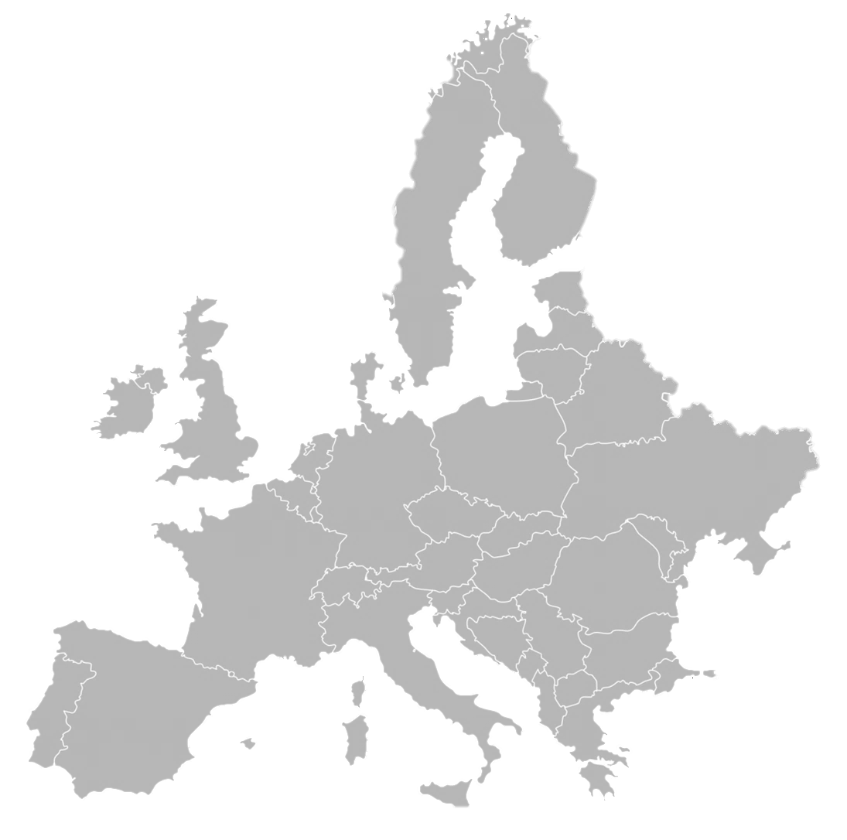
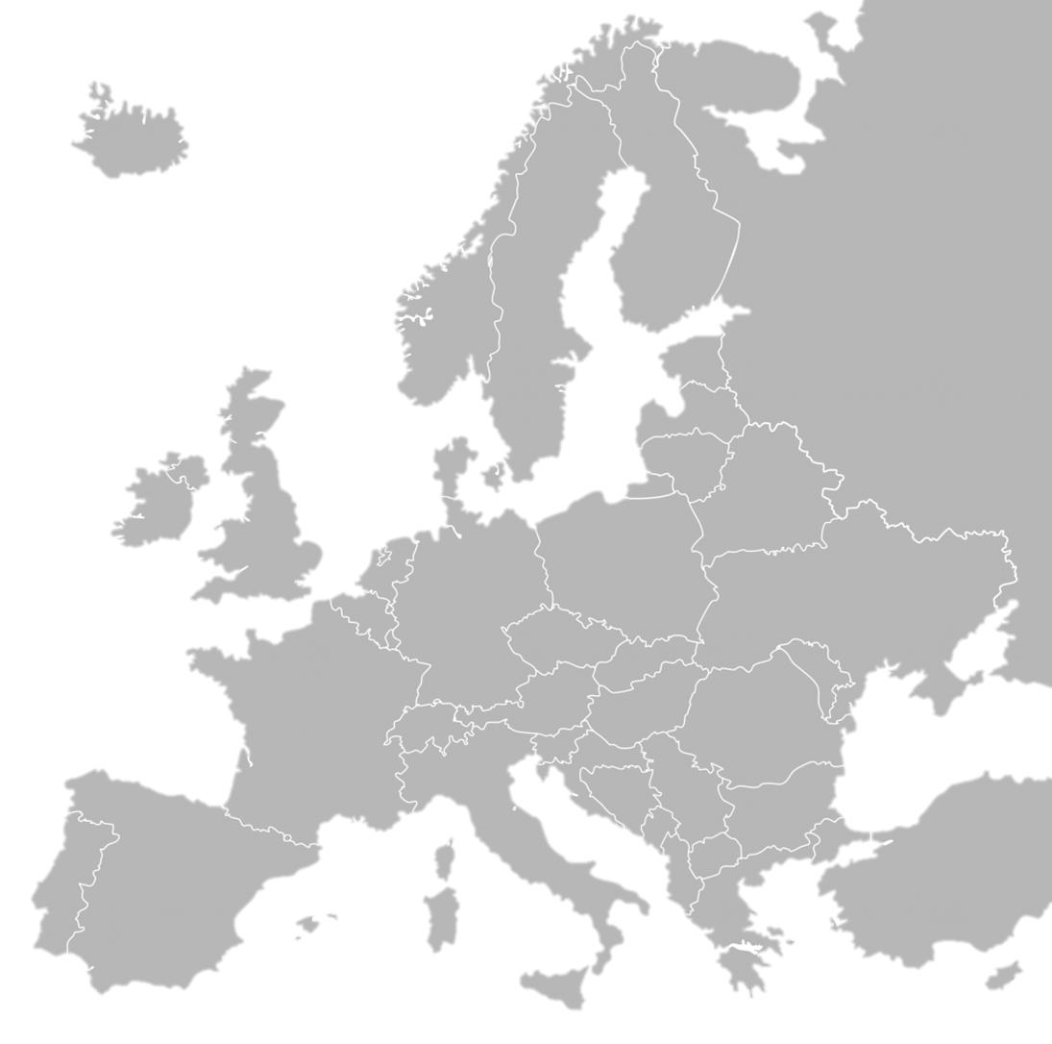
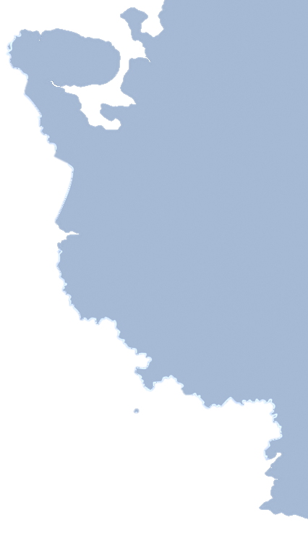
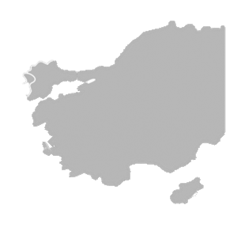
5. Accès aux marchés
      Accès au marché de l'Union européenne sans aucun droit à payer, ni contingents tarifaires, avec une population de 500 millions
      CEI (Communauté des États indépendants )– marché encore mal pénétré avec un fort potentiel
      Accès au marché de la Turquie sans droit à payer avec près de 80 millions d'habitants
      Moyen-Orient - un marché à fort pouvoir d'achat
      Marché nord-africain
Notes:
Access to markets
Due to its location Bulgaria provides direct access to the following key markets:
European Union - zero tariff market with population of 500 million
CIS – still not well penetrated market with a high potential
Turkey - zero tariff market of near 80 million population
Middle East – a market with high purchasing power
North African market

Slide 13
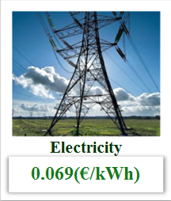
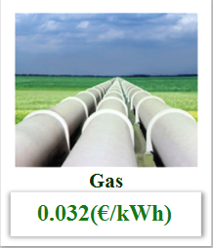
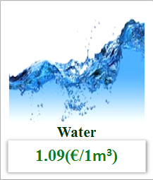
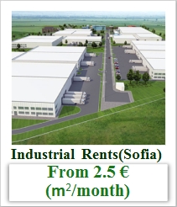
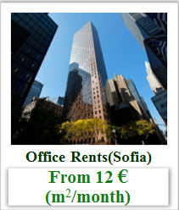
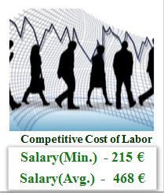
Coût compétitif des affaires

Slide 14
Bulgarie-Belgique: relations économiques
Commerce
Importation bulgare vers la Belgique: EUR 558 millions | Exportation belge vers la Bulgarie: EUR 542 millions
Métaux Machines et équipements Produits végétaux Textile Equipement de transport | Machines et équipements Equipement de transport Produits chimiques Plastiques Textile

Slide 15









Bulgarie-Belgique: relations économiques
Investisseurs belges en Bulgarie

Slide 16

Présidence bulgare de l’UE
L’Union fait la force
Priorités:
L’avenir de l’Europe et des jeunes – cohésion économique et sociale
Sécurité et stabilité en Europe forte et unie
Perspective européenne et connectivité des pays des Balkans occidentaux
Economie numérique et compétences nécessaires pour l’avenir
Eu2018bg.bg
Bulgarian Presidency of the Council of the European Union

Slide 17
Merci pour votre attention!

